Slide 1
Chapter 2: Project Management

Slide 2
Learning Objectives
Learn how to manage the scope, refine estimates and manage the risk of a project
Become familiar with how to staff a project

Slide 3
Introduction
Project Management is the process of planning and controlling system development within a specified time at a minimum cost with the right functionality
A project is a set of activities with a specified beginning and end point meant to create a system that brings value to the business
Project Managers monitor and control all tasks and roles that need to be coordinated
Inception phase: generate a system request based on a business need or opportunity
Perform a feasibility analysis; revise the system request
Approve or decline the project

Slide 4
Project Management Tools
Aids in creating workplans
Identify all tasks, their sequence and estimate the time to complete each one
Work breakdown structures (WBS): a hierarchy of tasks to identify:
Duration of each task
Current status of each task
Task dependencies (shows which tasks must be completed before others can begin)
Gantt charts: horizontal bar chart that shows the WBS graphically
Network diagrams: PERT and CPM

Slide 5
Project Effort Estimation
Estimation involves trade-offs between functionality, time and cost
It is the process of assigning projected values for time and effort
Most accurate estimates come from experience
Use-case point method; based on:
Technical complexity factors (13)
Environmental factors (8)

Slide 6
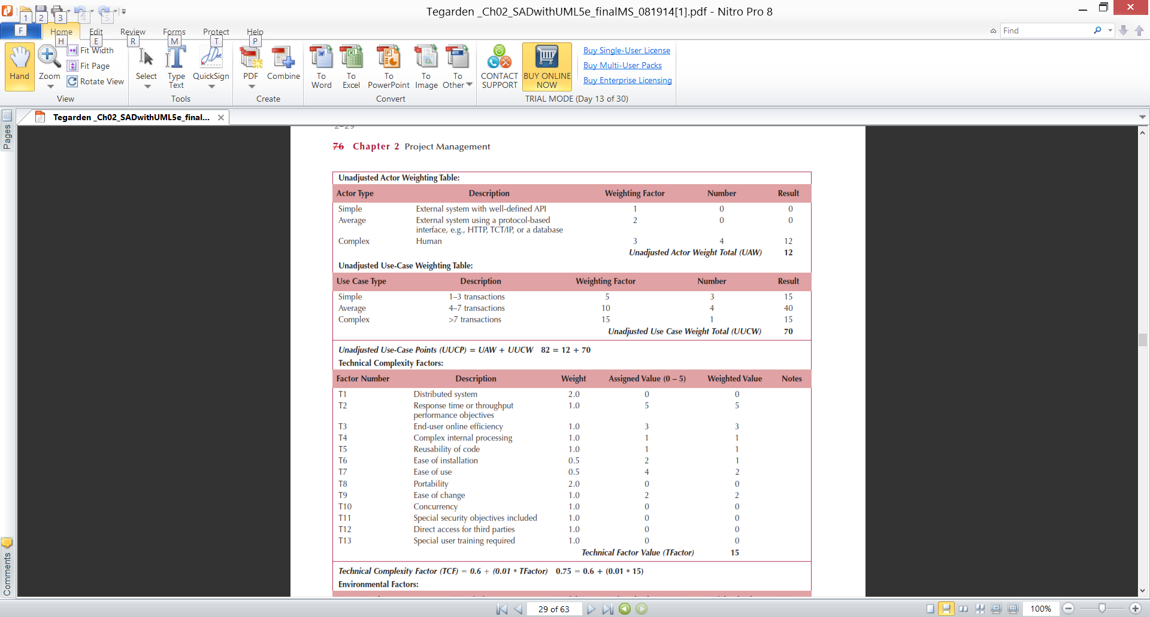
Use-case Estimation Example
Actors & Use-cases:

Slide 7
Use-case Estimation Example
Technical complexity factors:

Slide 8
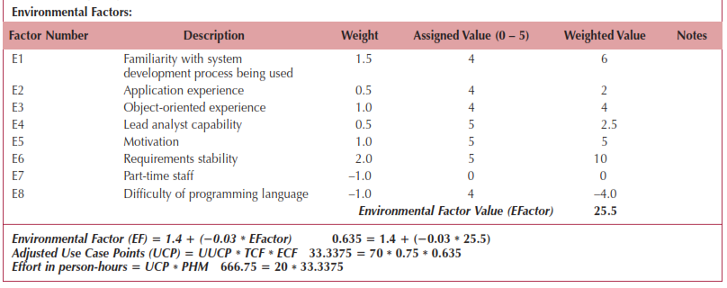
Use-case Estimation Example
Environmental factors & final estimate:

Slide 9
Creating & Managing the Workplan
Workplan: a dynamic and sequential list of all tasks needed to complete a project
Approaches:
Modify existing or completed projects
Derive the tasks from the methodology being used
Unified Process:
Iterative & incremental
Workplan is also iterative & incremental
Tasks and time intervals follow the phases
Different tasks executed for each workflow

Slide 10
Scope Management
Scope “creep”
Occurs after the project is underway
Results from adding new requirements to the project
Can have a deleterious effect on the schedule
Techniques to manage the project scope:
Identify all requirements at the outset
Allow only those changes deemed absolutely necessary
Carefully examine the impact of suggested changes
Delay some changes for “future enhancements”
Time boxing

Slide 11
Staffing the Project
Goals:
Determine how many people are required
Match skill sets to required activities
Motivate the team to meet the objectives
Minimize conflicts
Deliverable—The staffing plan, which includes:
Number & kind of people assigned
Overall reporting structure
The project charter (describes the project’s objectives and rules)

Slide 12
Creating a “Jelled” Team
A team of people so strongly knit that the whole is greater than the sum of its parts
Characteristics of a jelled team:
Very low turnover rate
Strong sense of identity
A feeling of eliteness
Team vs. individual ownership of the project
Team members enjoy their work

Slide 13

The Staffing Plan
Calculate the number of people needed:
Lines of communication increase exponentially as people are added to a project
Create a reporting structure for projects with large numbers of people assigned
Form sub-teams as necessary
Assign the Project Manager, Functional lead & Technical lead
Pay attention to technical and interpersonal skills

Slide 14
Motivating People
Motivation is the greatest influence on performance
Monetary rewards usually do not motivate
Suggested motivating techniques:
20% time rule
Peer-to-peer recognition awards
Team ownership (refer to the team as “we”)
Allow members to focus on what interests them
Utilize equitable compensation
Encourage group ownership
Provide for autonomy, but trust the team to deliver

Slide 15
Handling Conflict
Preventing or mitigating conflict:
Cohesiveness has the greatest effect
Clearly defining roles and holding team members accountable
Establish work & communications rules in the project charter
Additional techniques:
Clearly define plans for the project
Make sure the team understands the importance of the project
Develop detailed operating procedures
Develop a project charter
Develop a schedule of commitments in advance
Forecast other priorities and their impact on the project

